Slide 1
Preserving your computing environment
Discuss the significance of enhancing reproducibility in computational research
Present the root causes of "dependency hell"
Outline strategies to manage project dependencies more effectively
Notes:
During this session…

Slide 2
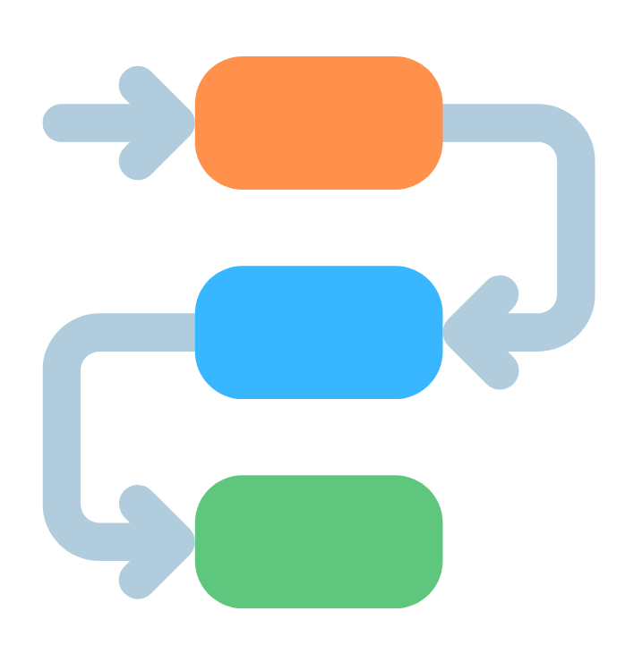
What is a dependency?
A directional connection between two or more elements, indicating a logical or sequential relationship among them.
If any of these elements fail, it poses a risk to both the efficiency of the process and the intended outcome.
Notes:
We can understand dependency as any task, occurrence, or condition that depends on the completion of a former task. Or, on which a following task is dependent on.
An analogy that I like to use is the “Domino Effect”...if one piece if one falls out of sync, it can disrupt the entire sequence.

Slide 3

Computing dependencies
System-level libraries and packages
System configurations
Operating system
Notes:
Libraries and packages are not the exclusive issue here, there are other layers to that problem.

Slide 4
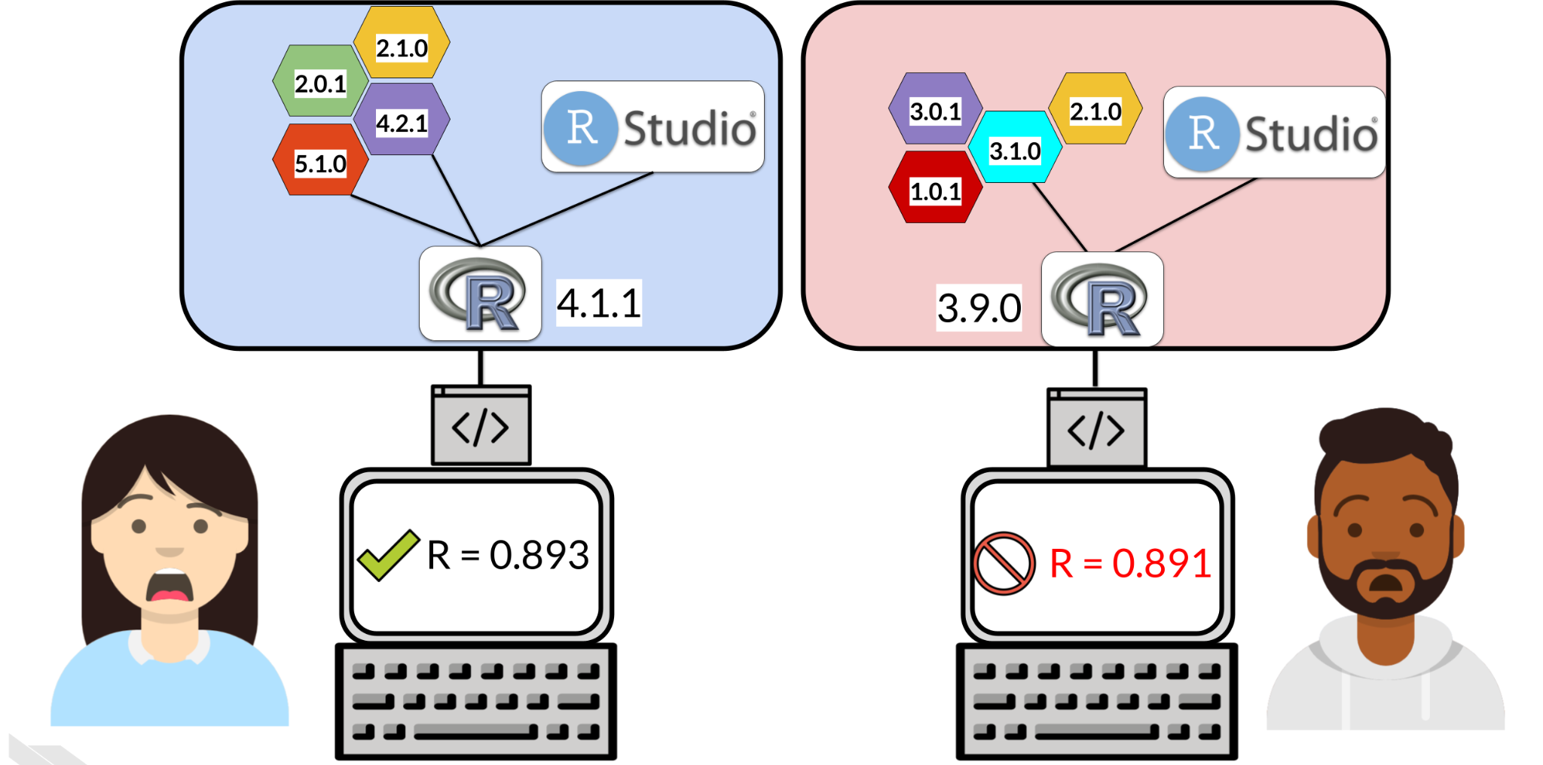
I swear it worked on my machine…
Image by: Savonen (2022).
Notes:
More common than we think…both the problem, and our reaction when it happens…

Slide 5
The Dependency Hell
Why?
Package versions don’t match
R versions don’t match
Ask yourself:
What are the packages versions used for my project?
Will my project be usable on other system or in the future?
How to deal with projects requiring different versions of a package?

Slide 6
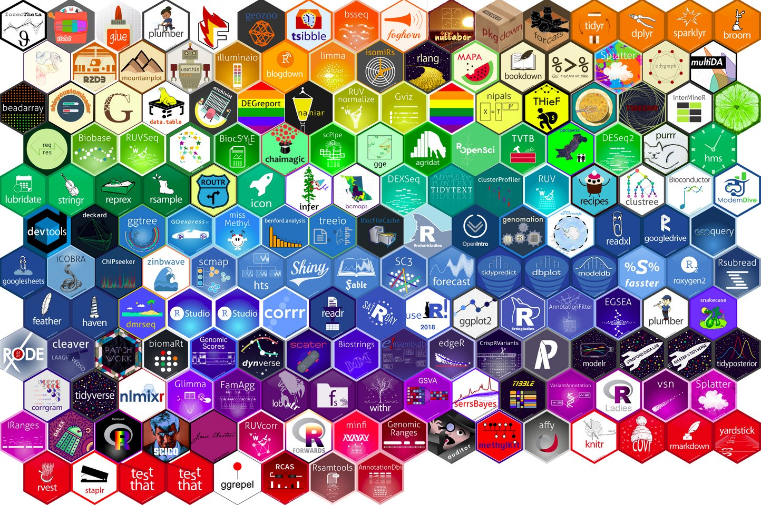

Packages & Libraries
R: Packages are collections of R functions, data, and compiled code in a well-defined format, created to add specific functionality. The directories where the packages are installed are called libraries.
Python: A library is a collection of code that makes everyday tasks more efficient.
Notes:
Quick note…Some language clarification; In R the location or path packages are stored are called libraries, whereas libraries in python are equivalent to packages in R….even though when loading a package in R we use the function library…I know…
Terminology clarified…let’s get back to dependencies

Slide 7

Recommendations
Document your computing environment (i.e., operating system, software, and versions)
Ensure to record all packages and libraries along with their versions
Use dependency management systems and virtual environments to automate and streamline the steps above
Consider using containers to capture dependencies and offer an environment runtime
Notes:
Let’s move now to some general practices and more specific recommendations.
At a high-level, we advise researchers to…
We will cover available options to help you follow these recommendations.

Slide 8


Document
document
Include in your project folder a file that others can use to to know which libraries and software versions you used
sessionInfo()
pip freeze
Notes:
Another more advanced dependency management practice is to take a snapshot of your libraries and packages dependencies and provide the script others can more easily use to install required packages and libraries to run your code and reproduce your results.
As we mentioned, this does not exclude the importance of calling this information or link these files in the project README and the usage notes. Redundancy in this case is not a bad thing.

Slide 9

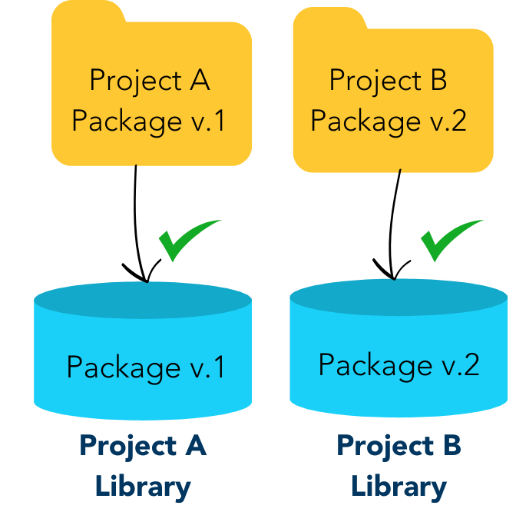
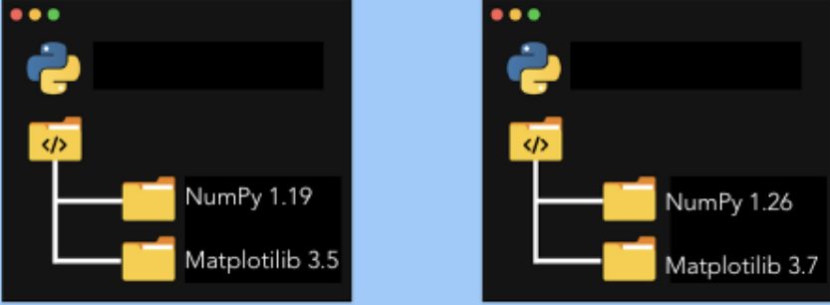
Virtual Environments
isolated | portable | reproducible
Virtual Environments
Renv
Venv
You can turn it on and off as will work in multiple projects without affecting on another!
Notes:
Package installs in R and Python are system wild by default, but a system-wide install can break your entire system.
Meaning that installing packages to reproduce other projects may affect your own environment and workflow when working on other projects. However, there are packages and modules to help us with that, and take a step further on dependency management. Virtual environment (venv) in Python and the Reproducible Environment (renv) for R are tools that allows you to create a dedicated environment for each project, ensuring that each project runs on its own specific version of packages or libraries. We can simply check in and check out this environment as we work with multiple projects.

Slide 10

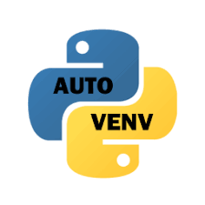
Renv & Venv
Isolation: enables adding or updating packages and libraries in one project without impacting other projects.
Portability: simplifies moving your projects across computers and platforms, streamlining required installations.
Reproducibility: pins precise package versions you rely on, ensuring consistent installations wherever you work.
Notes:
We won’t have time to cover these in detail today, but we have prepared some notes to help you get started with Renv and Venv: bit.ly/r-venv (paste in the chat)

Slide 11
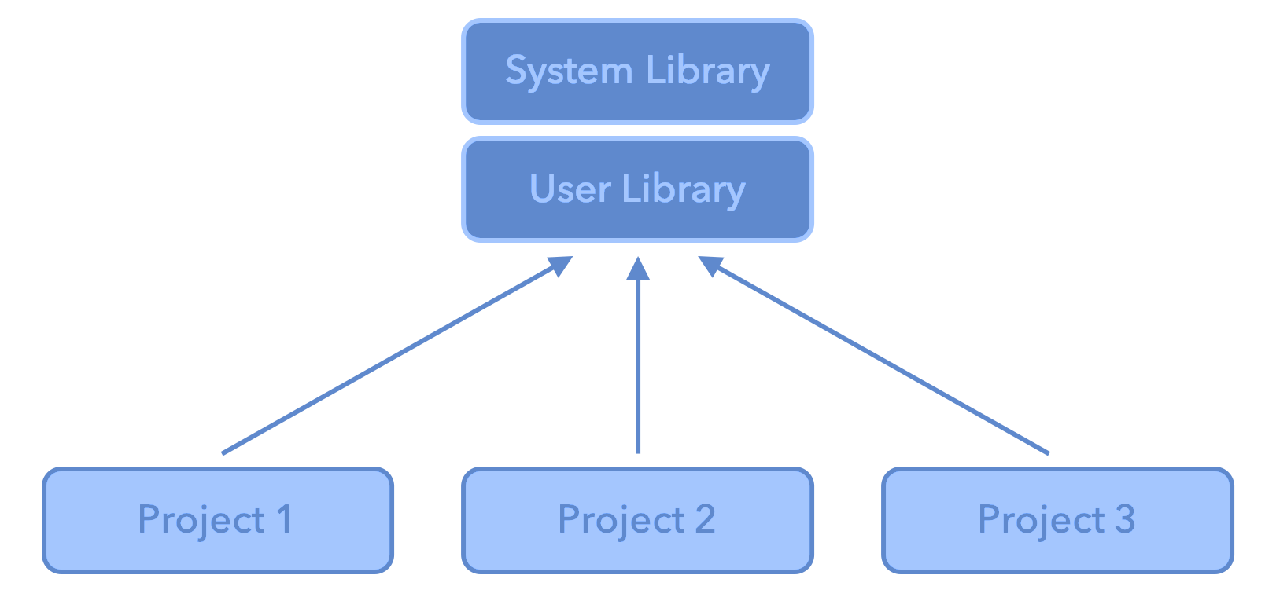
More into the problem - The R System
.libPaths gets/sets the library trees within which packages are looked for. Each R session can use multiple library paths (user and system)
Different projects, different dependencies, but calling from the same library. All projects share the same versions of installed packages.

Slide 12

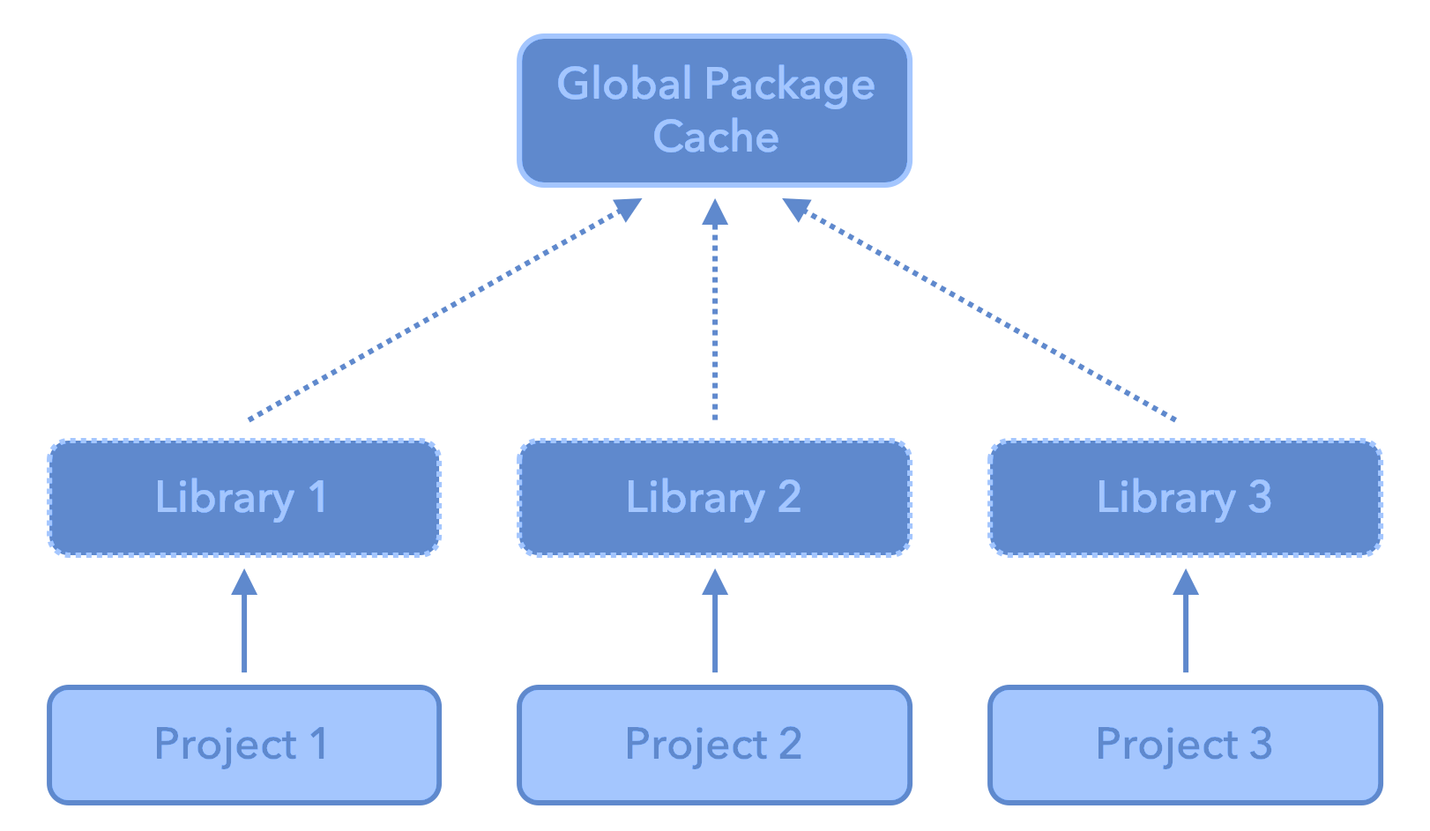
RENV
A project local library for each project

Slide 13
RENV
A dependency management toolkit for project-local libraries of R packages.
install.packages("renv")
Advantages:
Isolation: Each project gets its own library of R packages. In this way, you can upgrade and change package versions in one project without worrying about your other projects.
Portability: You can more easily share and collaborate on projects while ensuring all are sharing the same common base, by sharing a lockfile (renv.lock) which captures the state of your R packages.
Reproducibility: You can restore your R library exactly as specified in the renv.lock file.
https://rstudio.github.io/renv/articles/renv.html

Slide 14

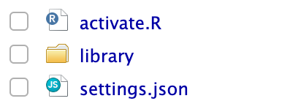

RENV Infrastructure
Used to activate renv for new R sessions launched in the project.
The activation script run by the project .Rprofile.
The private project library
Project-local settings that can be used to adjust the behavior of renv with your particular project.
The lockfile, describing the state of your project’s library at some point in time.

Slide 15
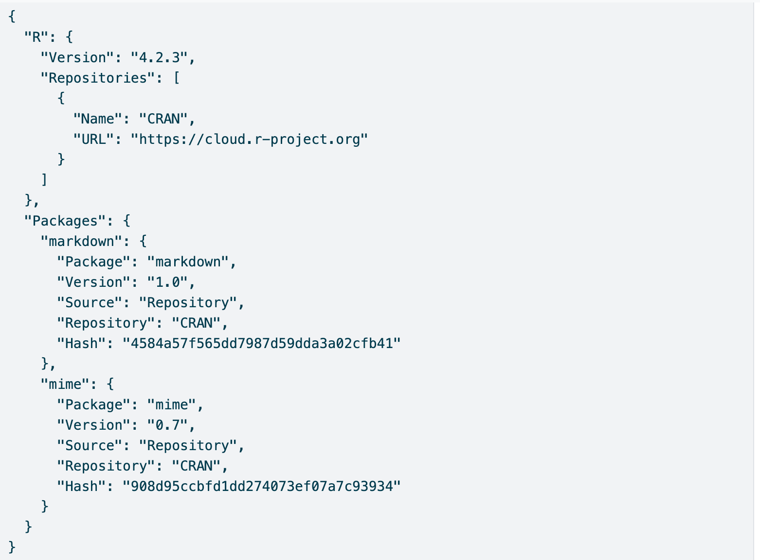
Anatomy of renv.lock file
The version of R used in that project;
The R repositories that were active when the lockfile was created;
Package records defining each R package, their version, and their installation source.
1
2
3
3

Slide 16
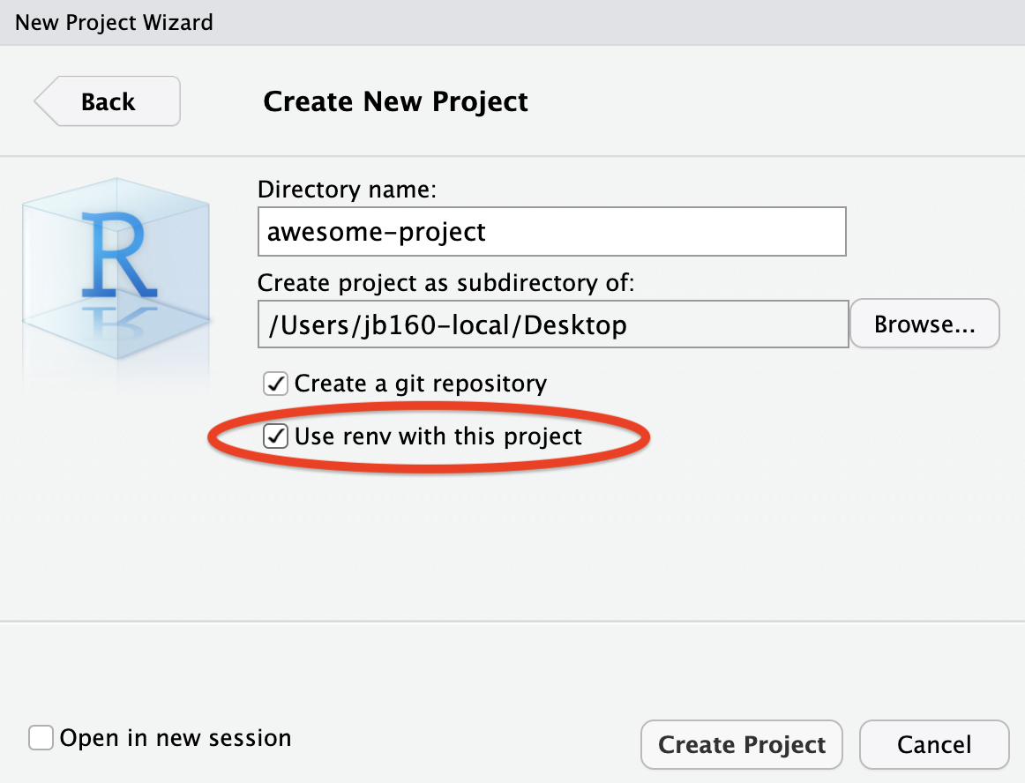
From the start of a project
Have you ever used it?

Slide 17
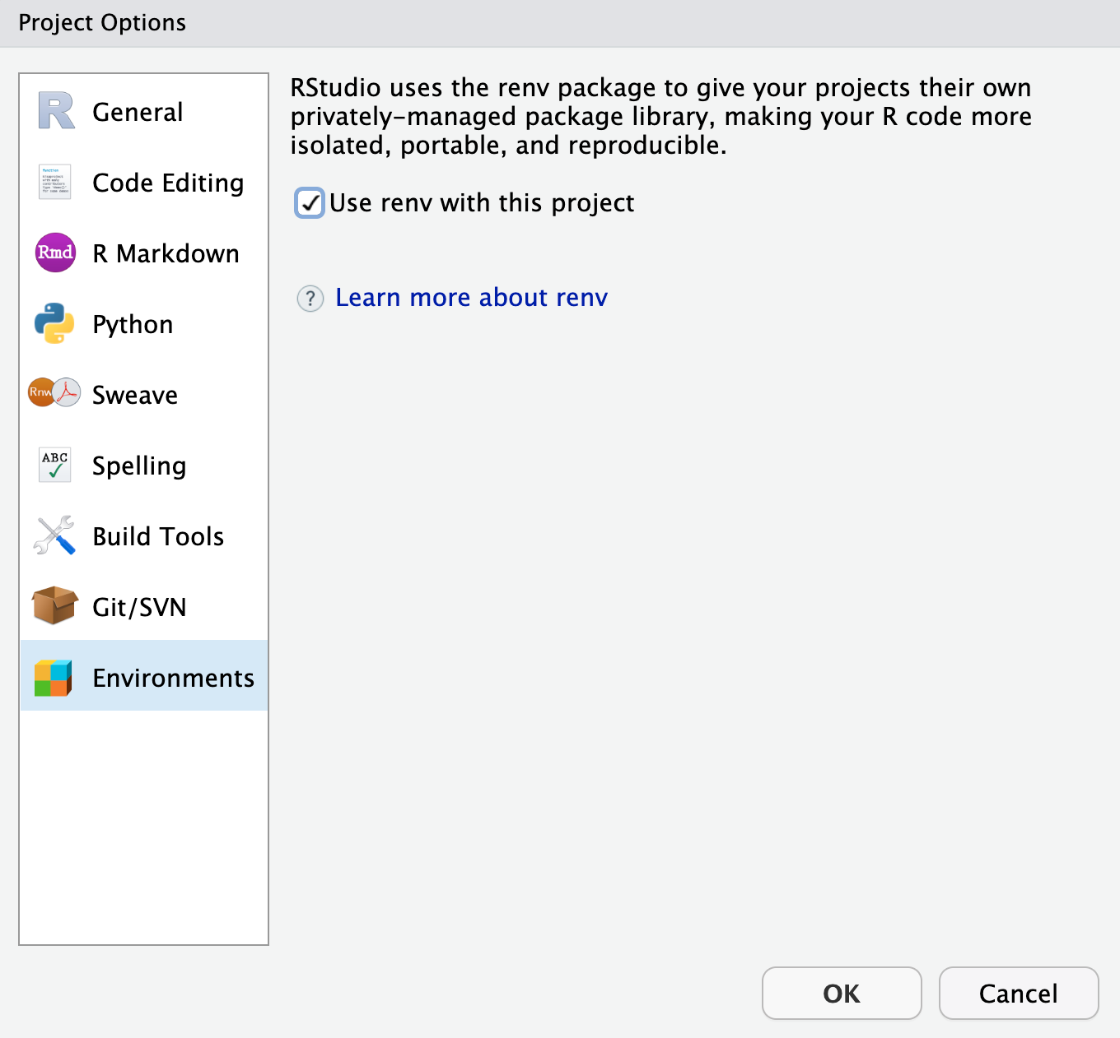
Or for an existing project

Slide 18
It’s never too late…
renv::init( )
renv::snapshot( )
renv::restore( )
Initialize a new project-local environment with a private R library
After updates, save the state of the project library to the lockfile (renv.lock)
Restore the state of your project from renv.lock. It examines your project’s R files to determine which packages are used in your project, and will include only those packages (alongside their recursive dependencies) in the lockfile.

Slide 19
Collaborating with RENV
Initialize renv in your project using renv::init( )
Share your project sources, including renv.lock, .Rprofile, and renv/activate.R and ensure that collaborators download and install the right version of renv when starting the project.
When a collaborator opens the project, renv will automatically bootstrap and download the appropriate version of renv.
If updates are made save them with renv::snapshot( )
After that, collaborators can use renv::restore( ) to restore the project library on their machine.

Slide 20
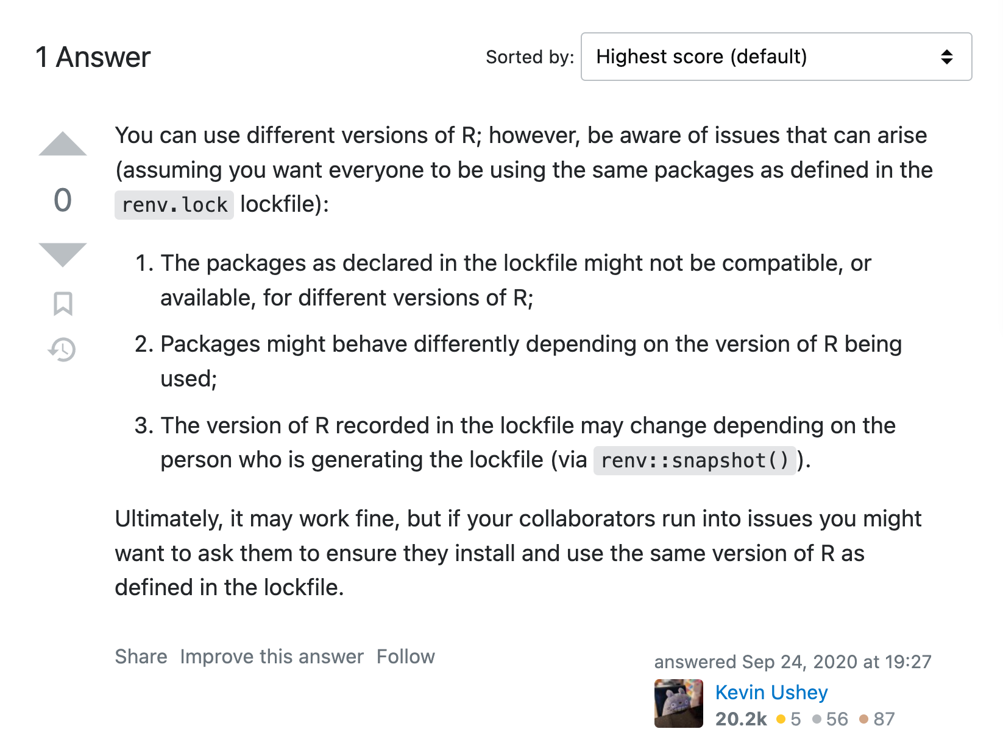
But there are limitations…

Slide 21

Binder-ize your project!
If on a repo (e.g., GitHub, Fighshare, Zenodo, Dataverse)
Let others and your future self avoid the “dependency hell”
Allow easier access and others to interact with your project with no installations needed

Slide 22
How?
Add two files to your repo (root directory):
“runtime.txt” - enter the R version of Python version in use
r-4.3.2-2023-03-15
python-3.10
install.R (R) or requirements.txt (Python) file with packages/libraries info
Access: https://mybinder.org
See examples: https://github.com/binder-examples
Notes:
Remember the install.R and requirements.txt files we mentioned earlier? They will be of great use her as well.
Note that environment.yml replaces runtime for python projects, since it specifies the python version.

Slide 23
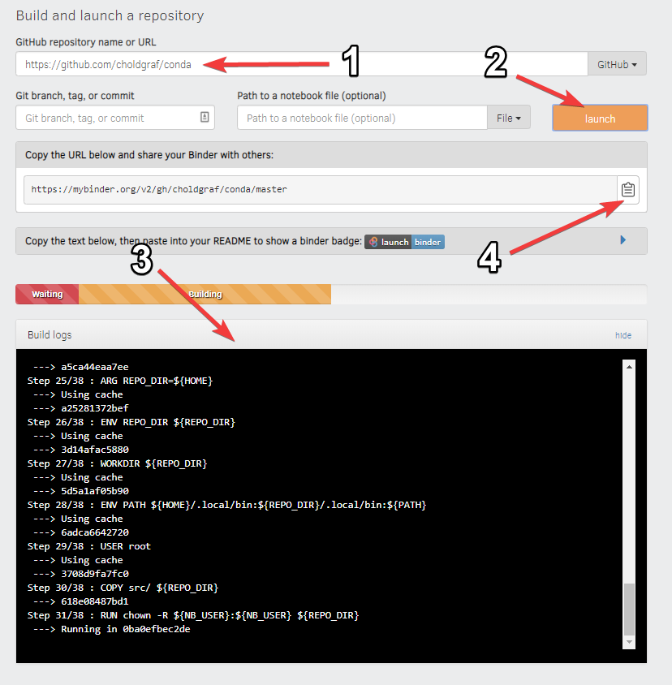
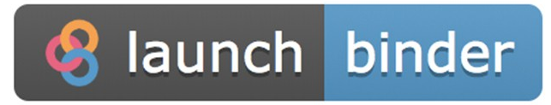
Select the appropriate repository and enter its URL or DOI
Click launch
Wait patiently wait for the environment to build.
Share the link to your “binder-ized” repository, or copy the supplied code snippet to your repository README to a badge so others can launch your project with a single click.
Notes:
After making your data and code publicly available via Github or another supported repository along with the files we just mentioned…you will access mybinder.org

Slide 24
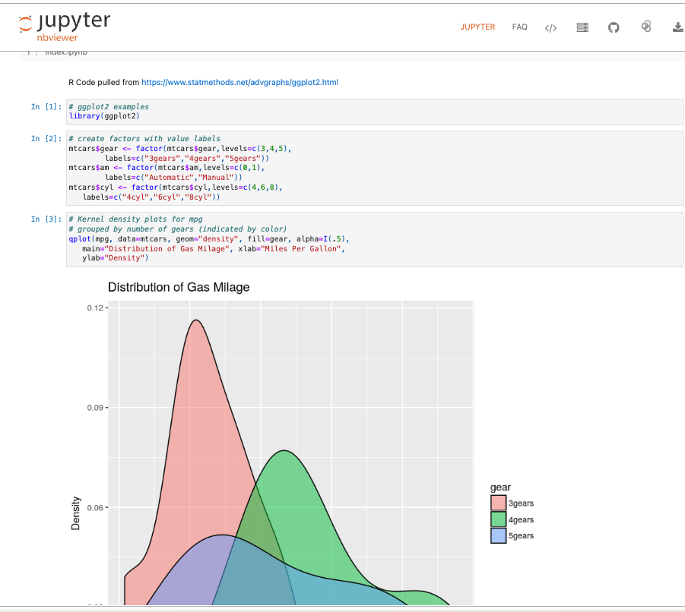

Slide 25

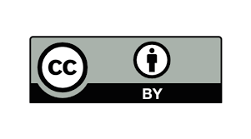
Acknowledgements
This content has been adapted from:
DEPENDENCY MANAGEMENT 101
Renata Curty
Research Data Services UCSB Library
rds@library.ucsb.edu

